Slide 1

Symmetric Encryption
Sarveshwar Mahapatro – 2019AAPS0257G
Abhijit Deo - 2019A8PS0041G
Jaskaran Chhabra - 2019A8PS0653G
Rahul Peter - 2019AAPS0230G

Slide 2
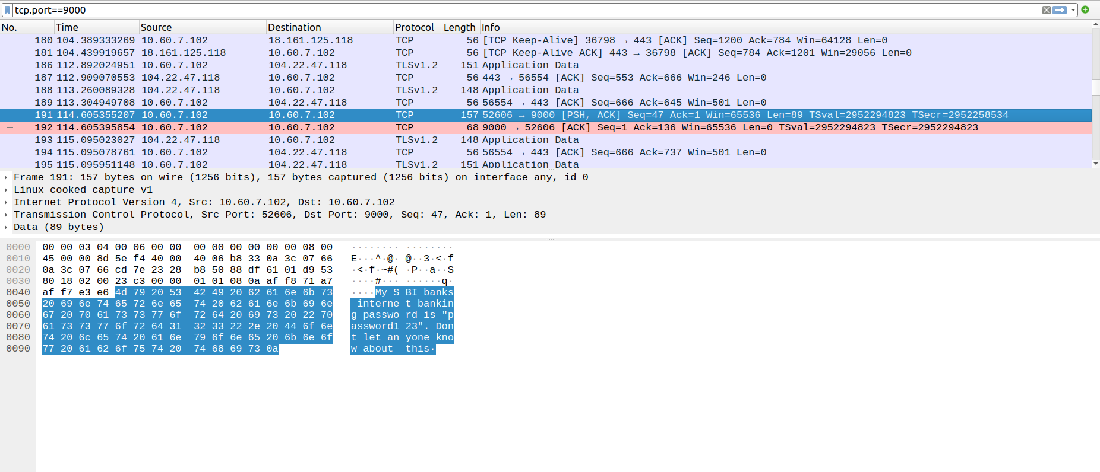
Data in the packets is exposed! Someone with access to the router can potential gain access to your data packets!
What to we do then?

Slide 3


Slide 4
Introduction to Encryption
Encryption is the process of converting plain text into cipher text to protect data from unauthorized access or theft. Encryption is a critical aspect of cybersecurity and is used in a wide range of applications, including secure communication, data storage, and financial transactions.

Slide 5
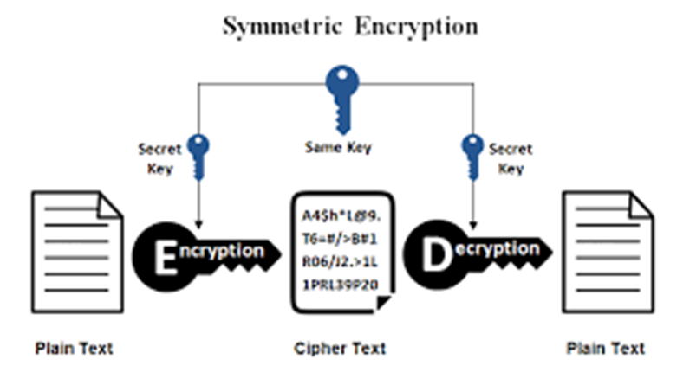
What is symmetric key encryption?
Symmetric key encryption, also known as secret key encryption, is a type of encryption that uses a single key to encrypt and decrypt data. The same key is used for both encryption and decryption, which means that the key must be kept secret from unauthorized parties.

Slide 6
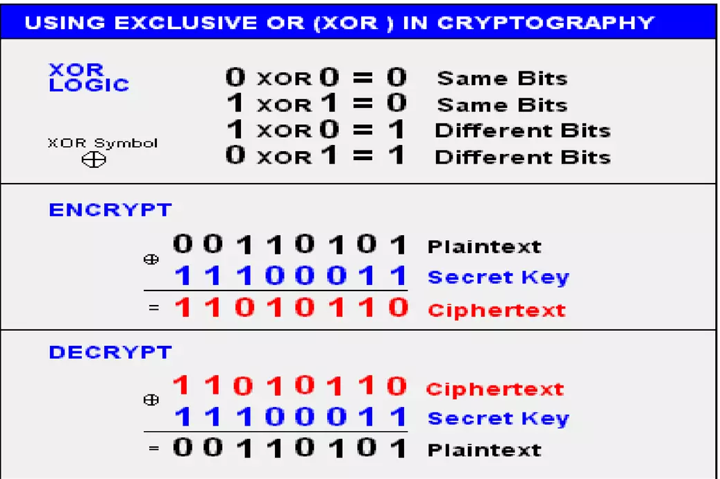
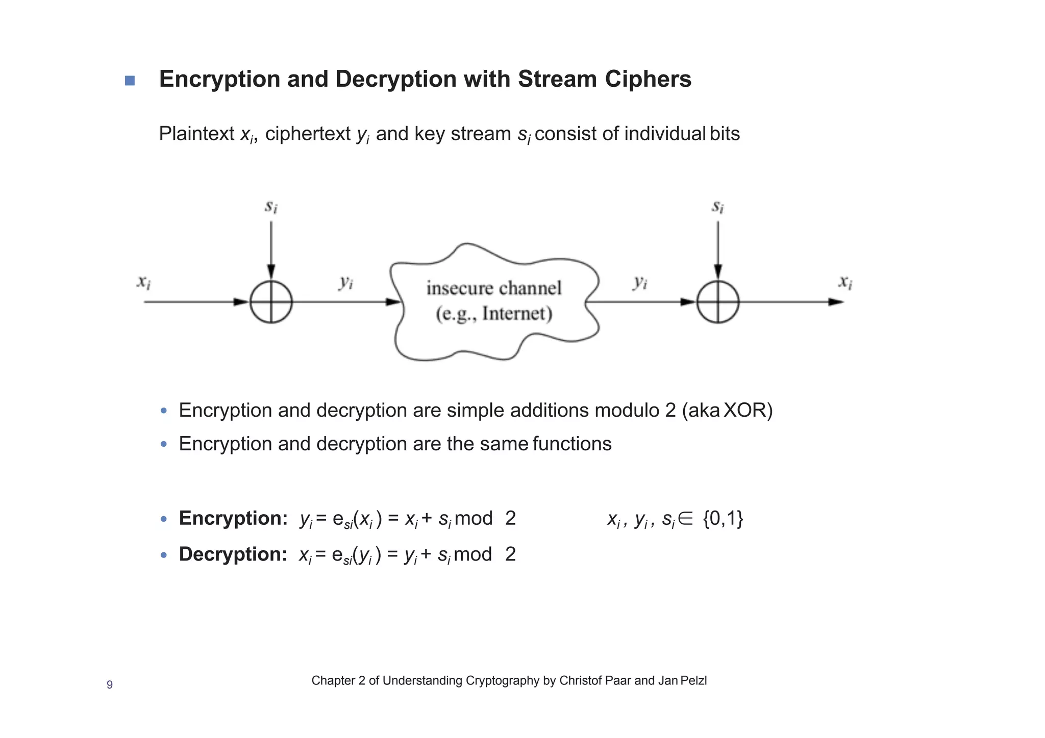
How does symmetric key encryption work?
Symmetric key encryption works by applying a mathematical algorithm to the plain text to generate cipher text. The algorithm uses the secret key to transform the plain data into cipher data. The same key is used to decrypt the ciphered text back into original data.

Slide 7
Symmetric key encryption process
The process of symmetric key encryption includes the following steps:
Key Generation: The key is generated randomly by the sender or a third party, and it must be kept secret from unauthorized parties.
Encryption: The sender uses the key and an encryption algorithm to convert the plain text into cipher text.
Transmission: The cipher text is sent to the receiver through a secure channel.
Decryption: The receiver uses the key and a decryption algorithm to convert the cipher text back into plain text.

Slide 8
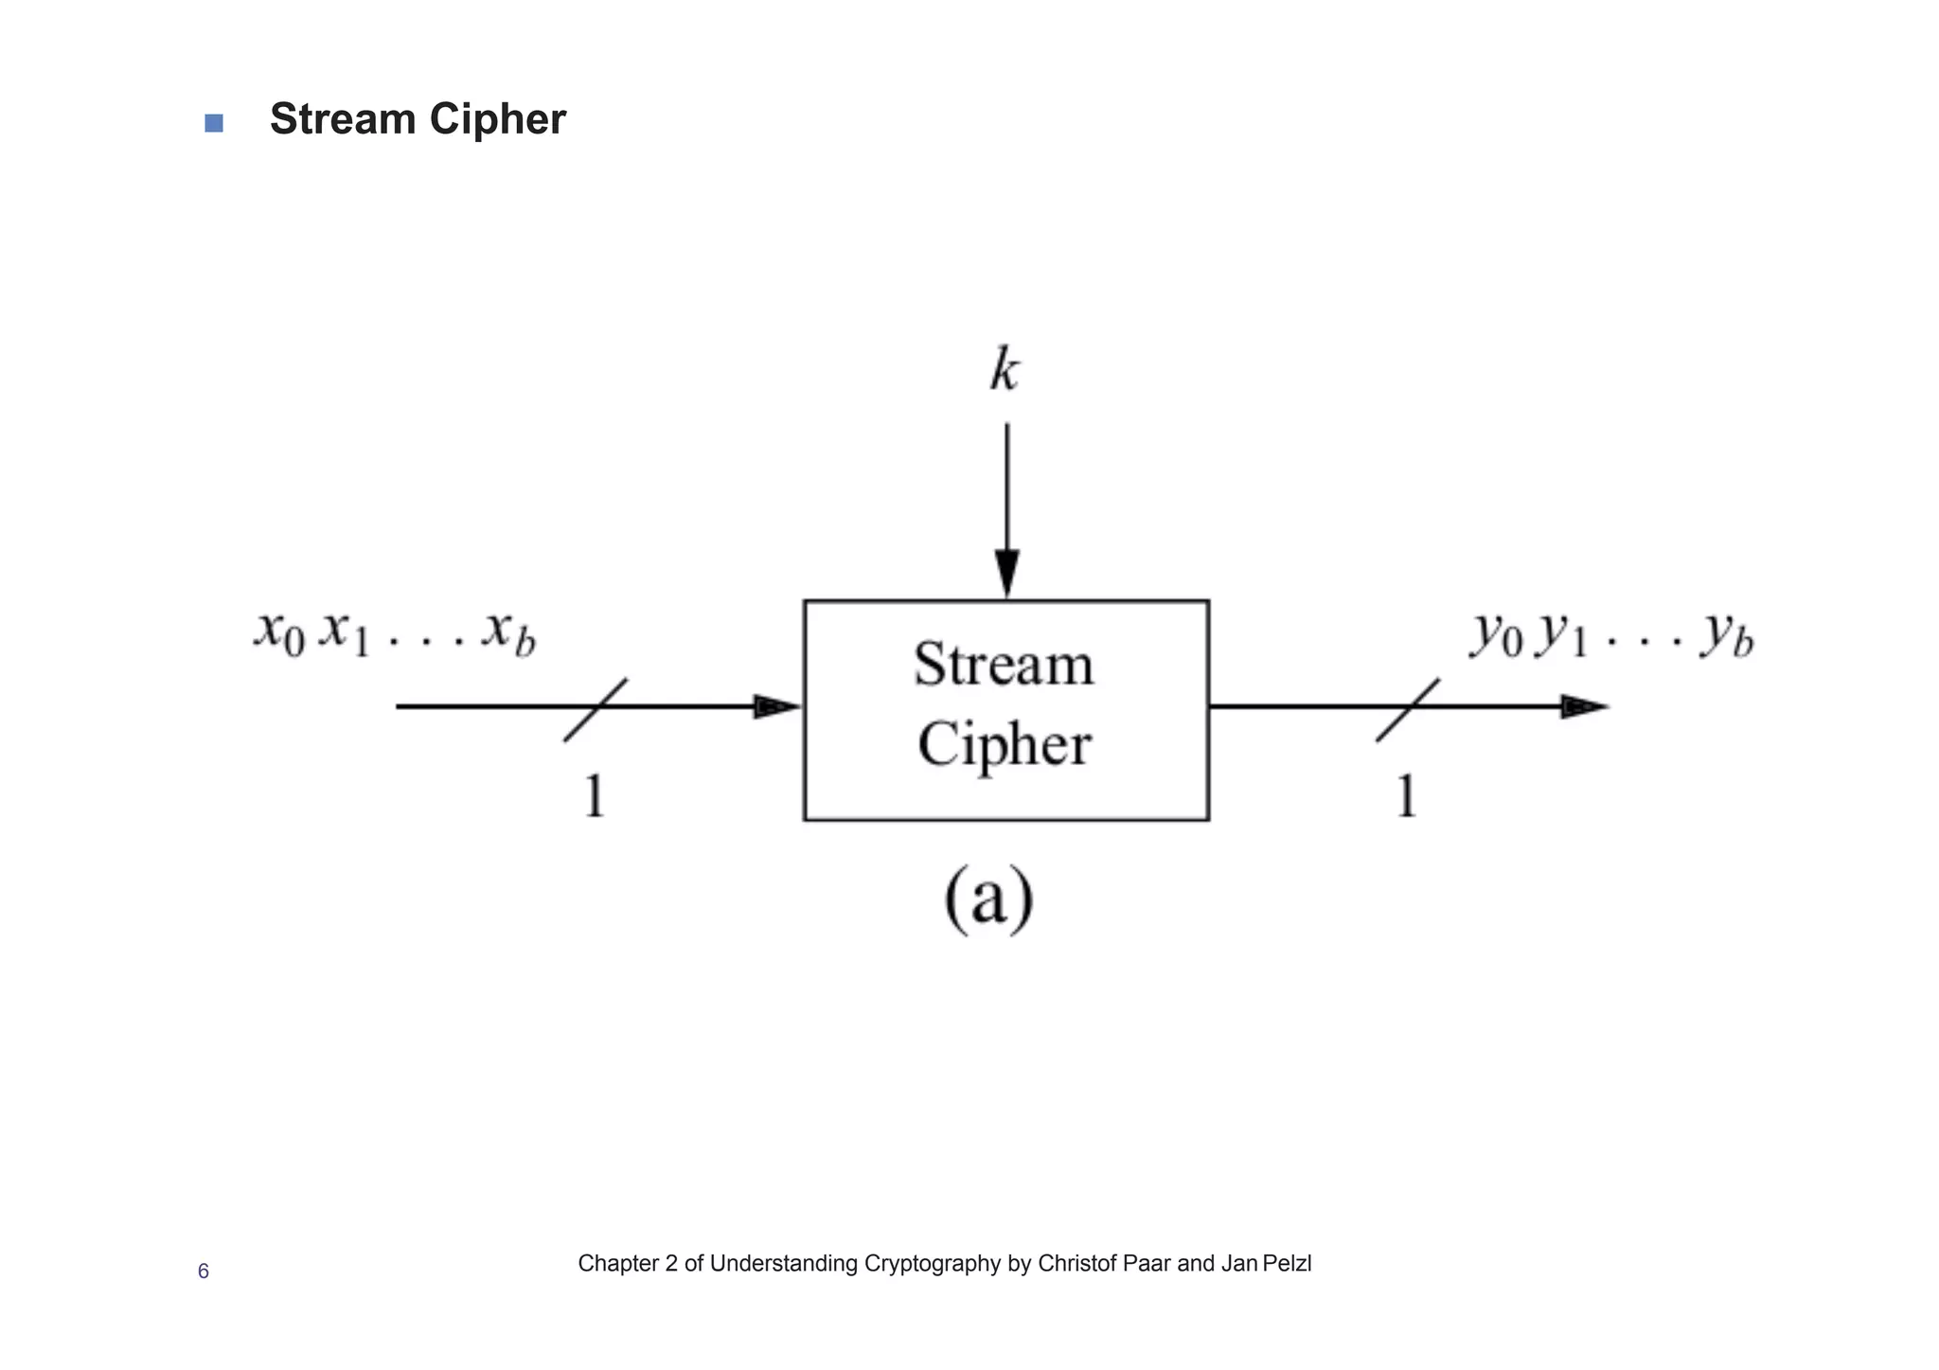
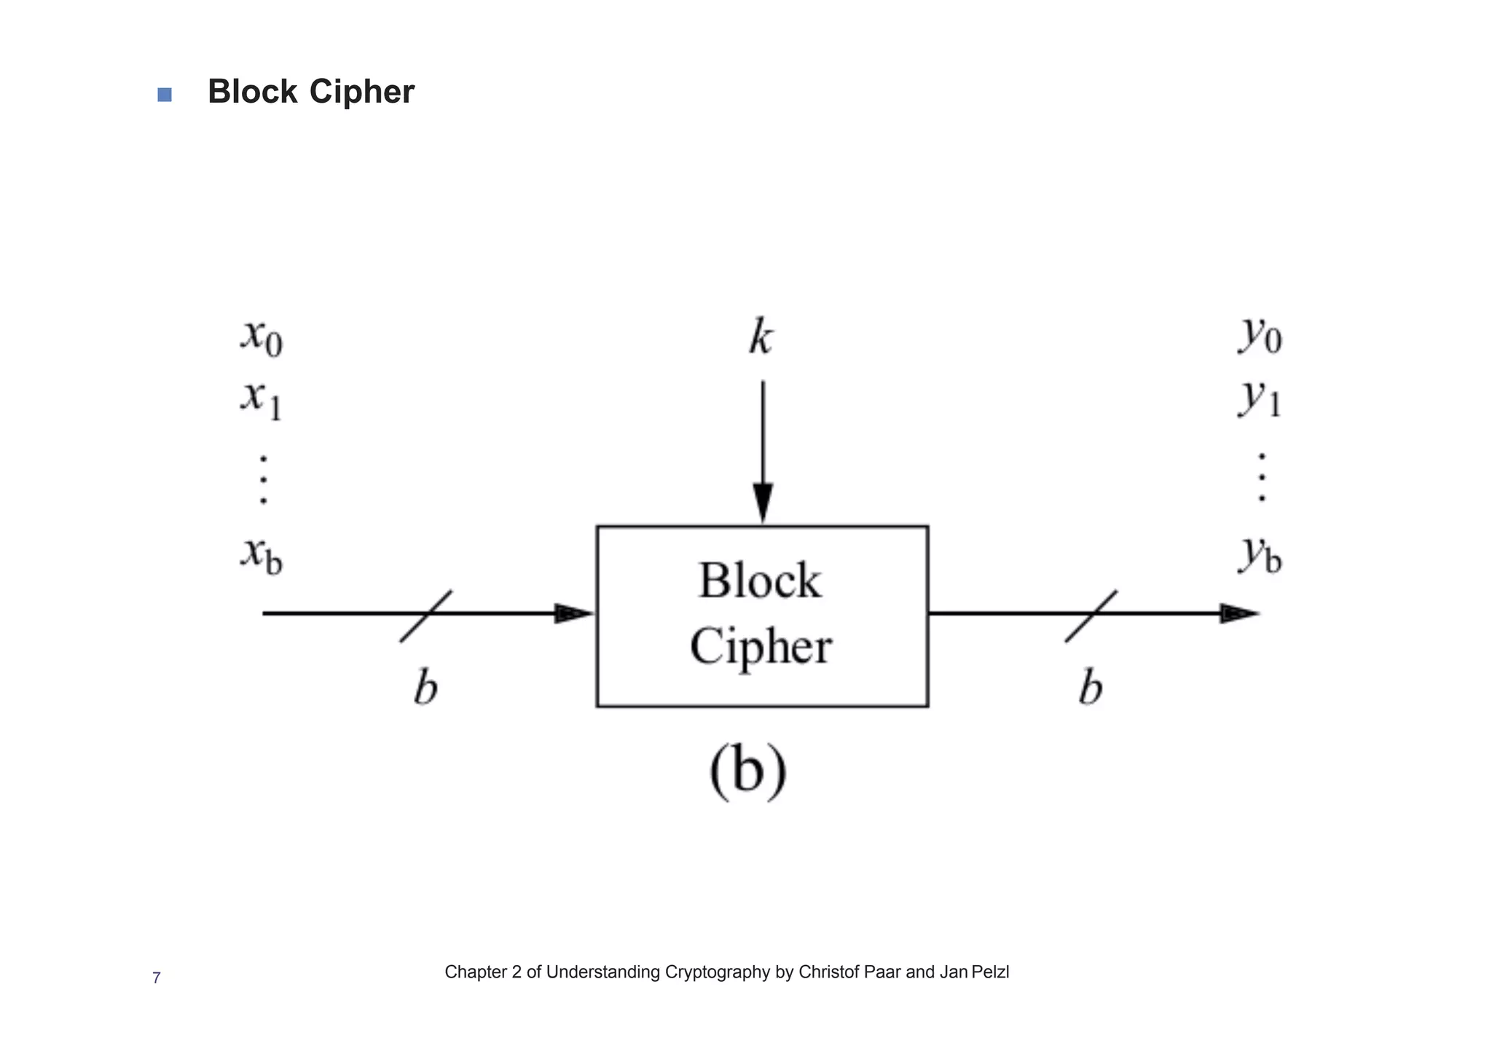
Types of symmetric key algorithms
These algorithms are a type of cryptographic technique in which we have to use a shared secret key for both encryption and decryption.
Its types are:
Stream ciphers
Block ciphers

Slide 9
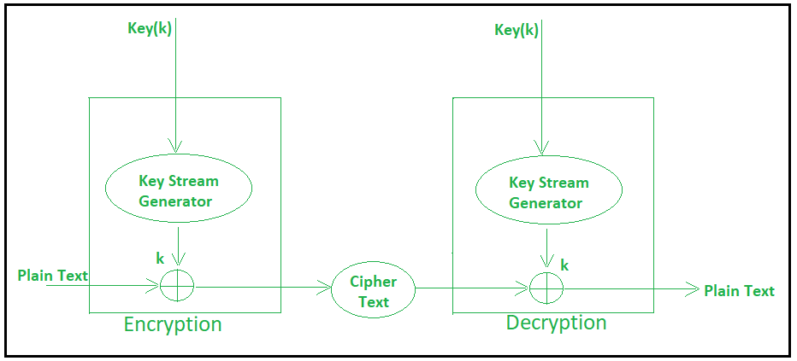
Stream Ciphers
It encrypts bits individually , one bit at a time.
Each bit in plain text is encrypted with a key and decrypted back to plain text.

Slide 10
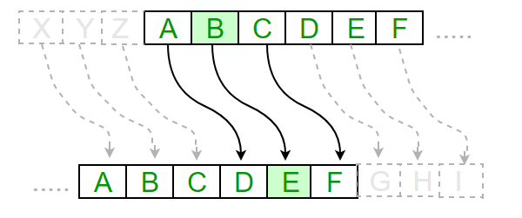
Example of Stream Cipher- Caesar Cipher
It’s a simple encryption technique which uses a shift integer (0-25)
Replacement of letter in the given text with another letter.
Shift of 3 would cause A to be replaced by D, B by E, C by F etc….
Encryption (E_{n}(x) = (x+n)mod(26)) & Decryption (D_{n}(x) = (x-n)mod(26))
Drawback - Not secure against modern decryption methods, vulnerable to frequency analysis attacks

Slide 11
Block Cipher
A block cipher is a type of cryptographic algorithm that takes a block of plaintext and transforms it into a block of ciphertext using a secret key.
The strength of a block cipher lies in the complexity of the mathematical operations used to scramble the plaintext, which typically involve substitution and permutation.
They are used to secure sensitive data in a wide variety of applications, including online banking, e-commerce, and communication systems.
They can be implemented in hardware or software with relatively low overhead, making them ideal for use in embedded systems, mobile devices, and other low-power applications.

Slide 12
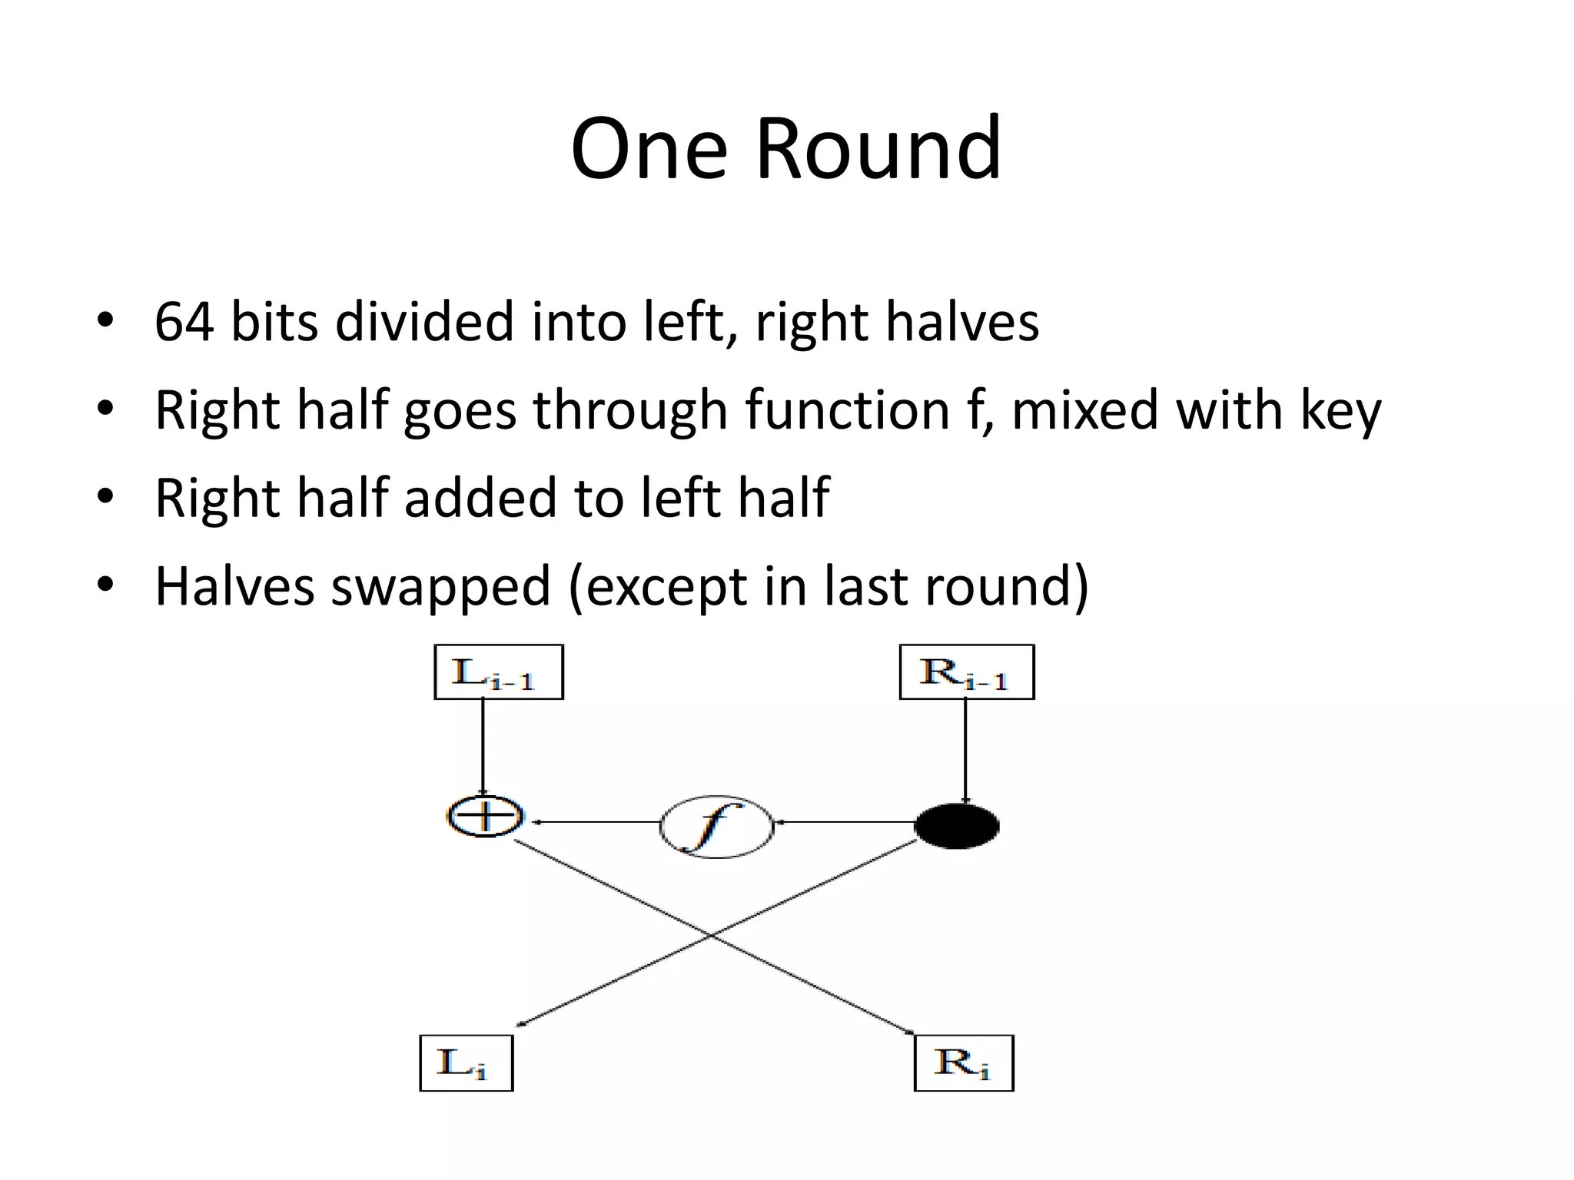
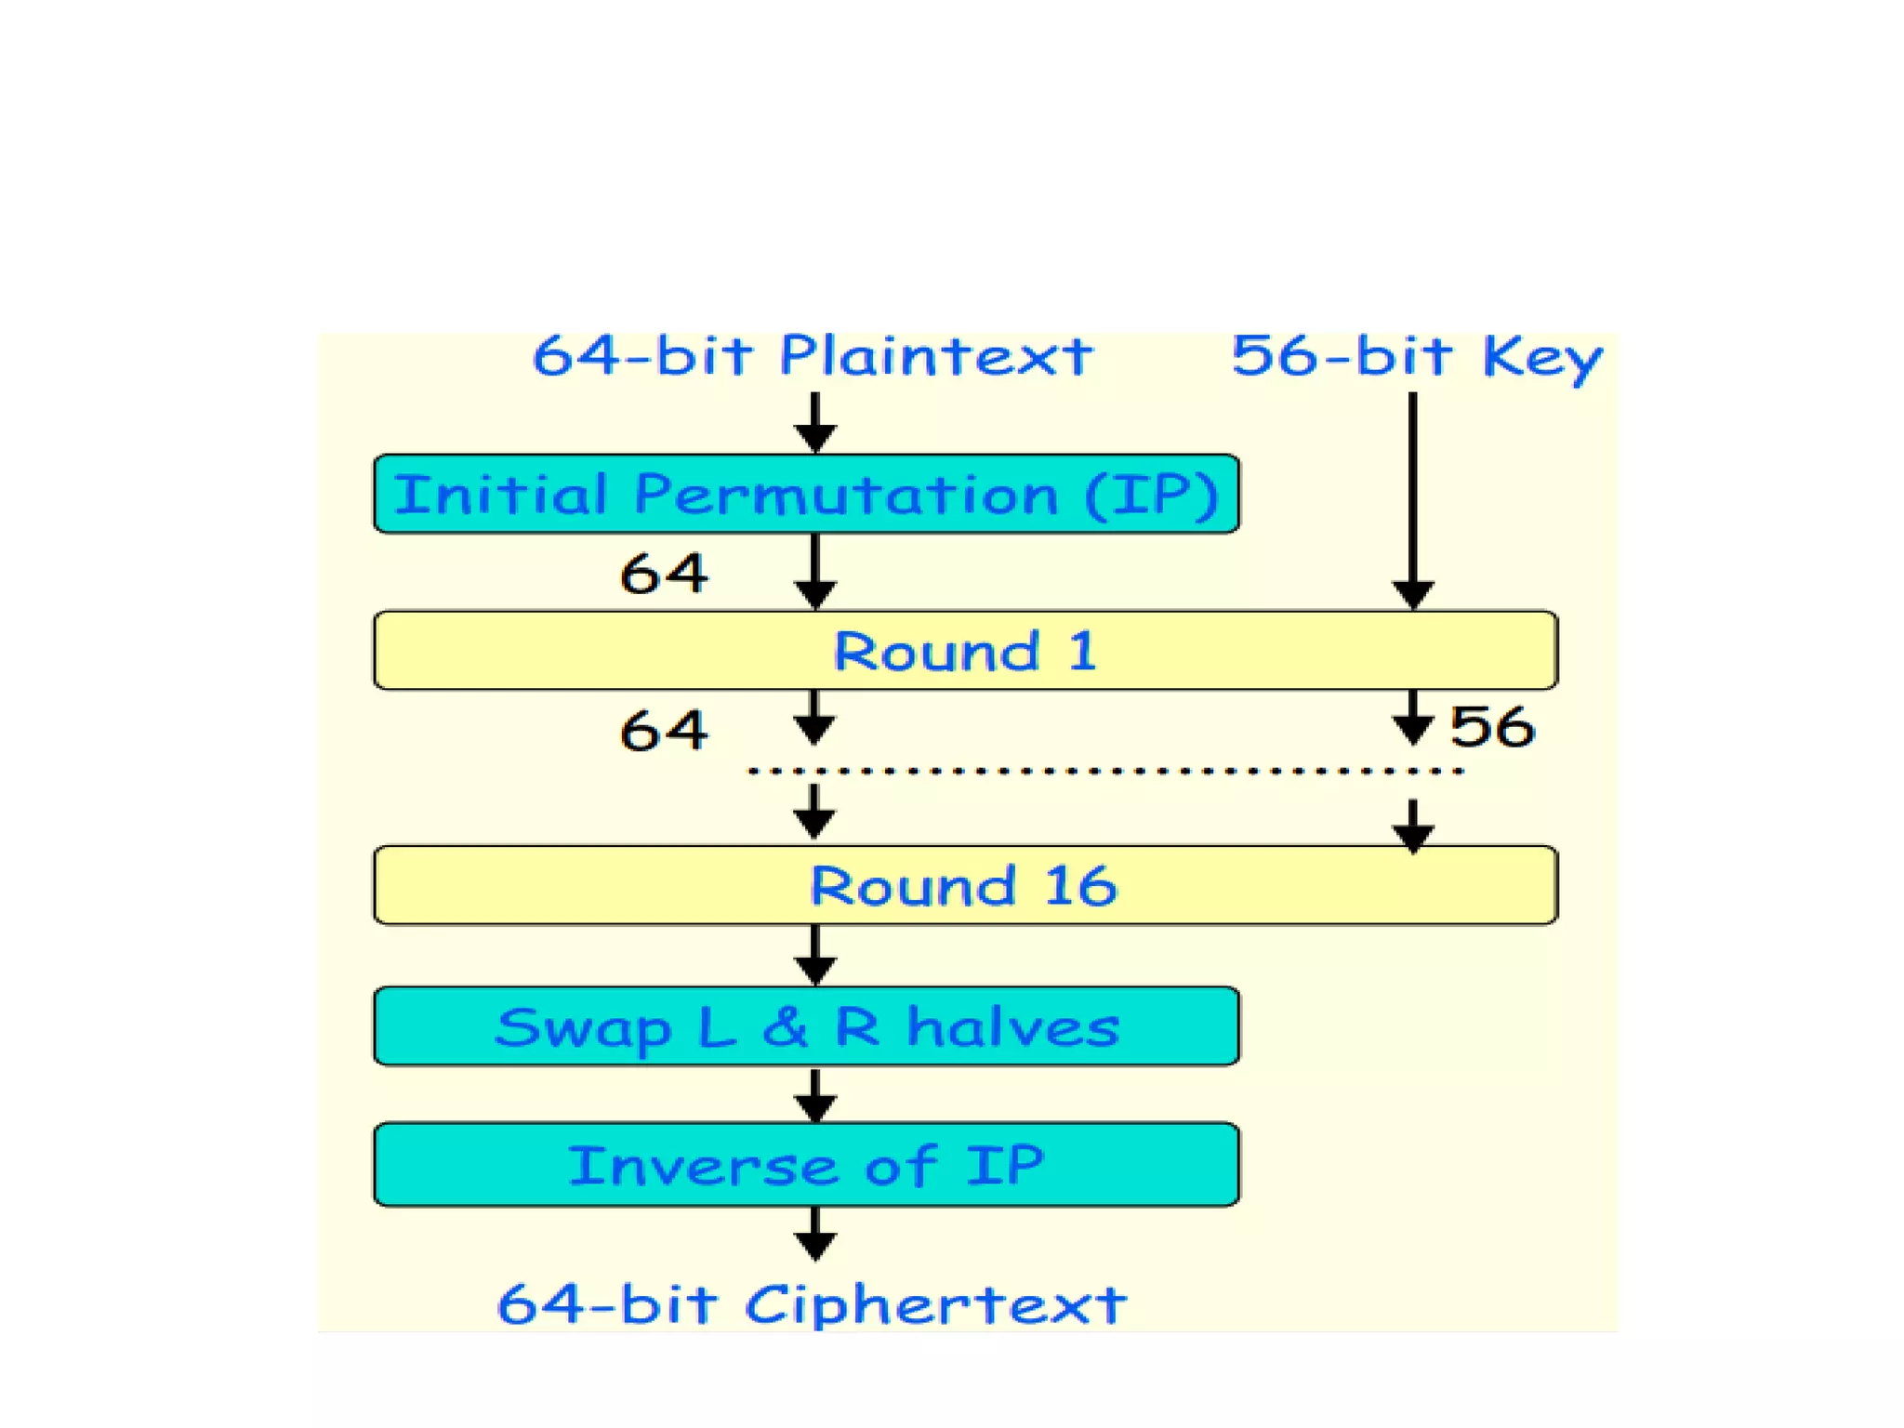
Example of Block Cipher - DES
DES is a block cipher algorithm that was widely used in the 1970s and 1980s.
In our example, plaintext is 64 bits and key size is 56 bits
DES operates on a substitution-permutation network.
DES is no longer considered secure due to its small key size, which makes it vulnerable to brute force attacks.

Slide 13
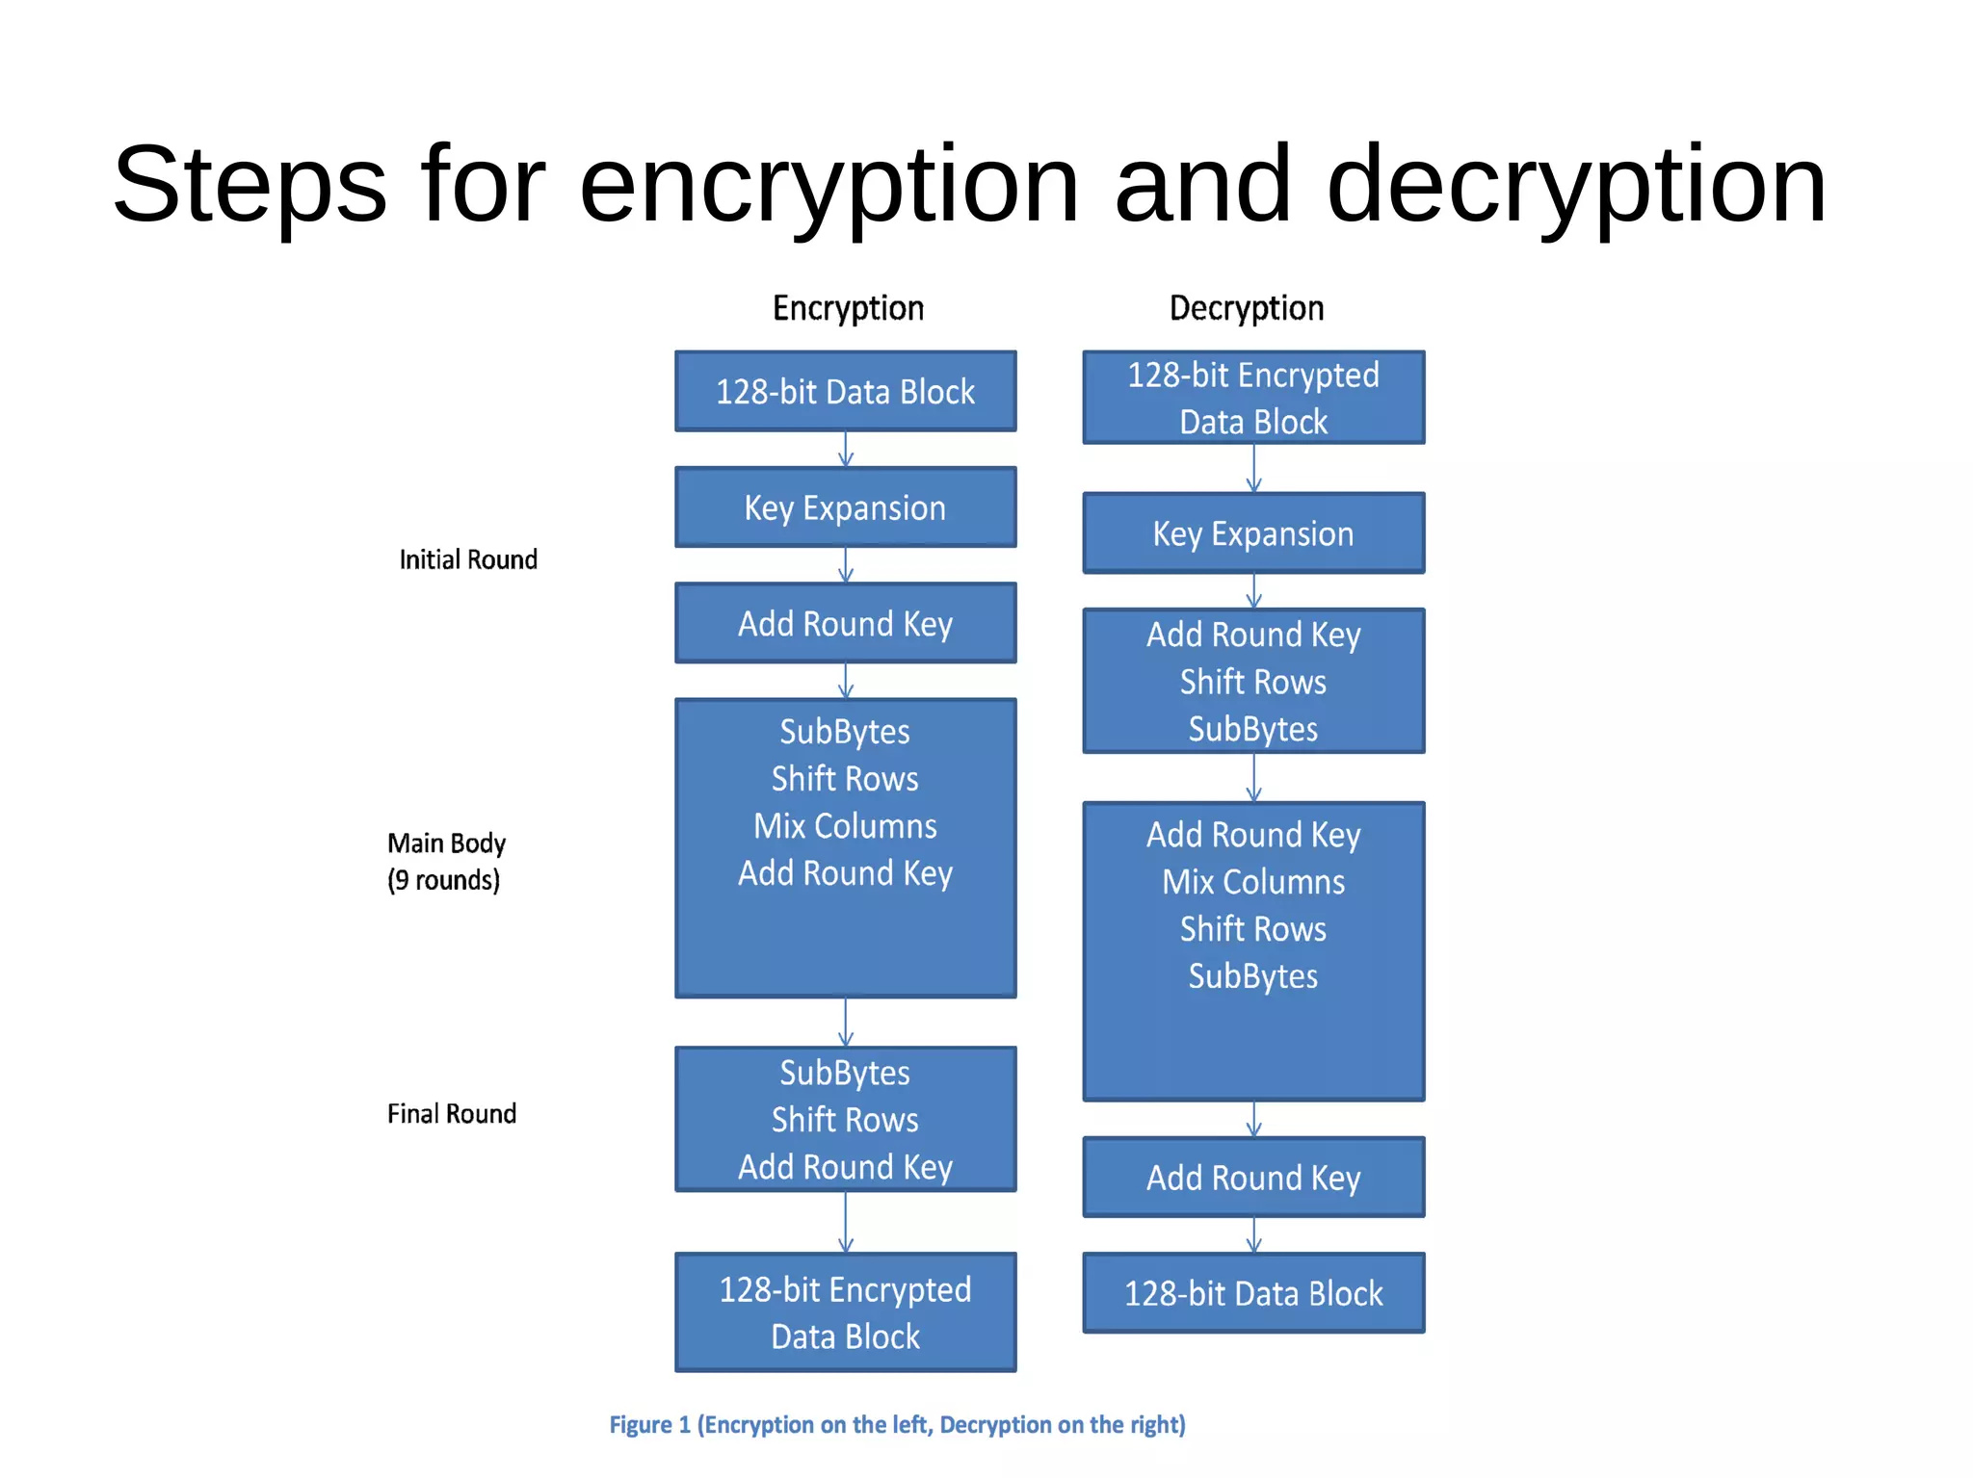
Examples of Block Cipher - AES
- AES is a widely used block cipher algorithm for securing sensitive data.
- It was developed by the National Institute of Standards and Technology (NIST) in 2001 as a replacement for the Data Encryption Standard (DES).
- AES uses a fixed block size of 128 bits and supports key sizes of 128, 192, or 256 bits.
- It operates on a substitution-permutation network, where the plaintext is divided into fixed-size blocks and processed through a series of mathematical operations.
- AES is considered to be highly secure, with no practical attacks against it.

Slide 14
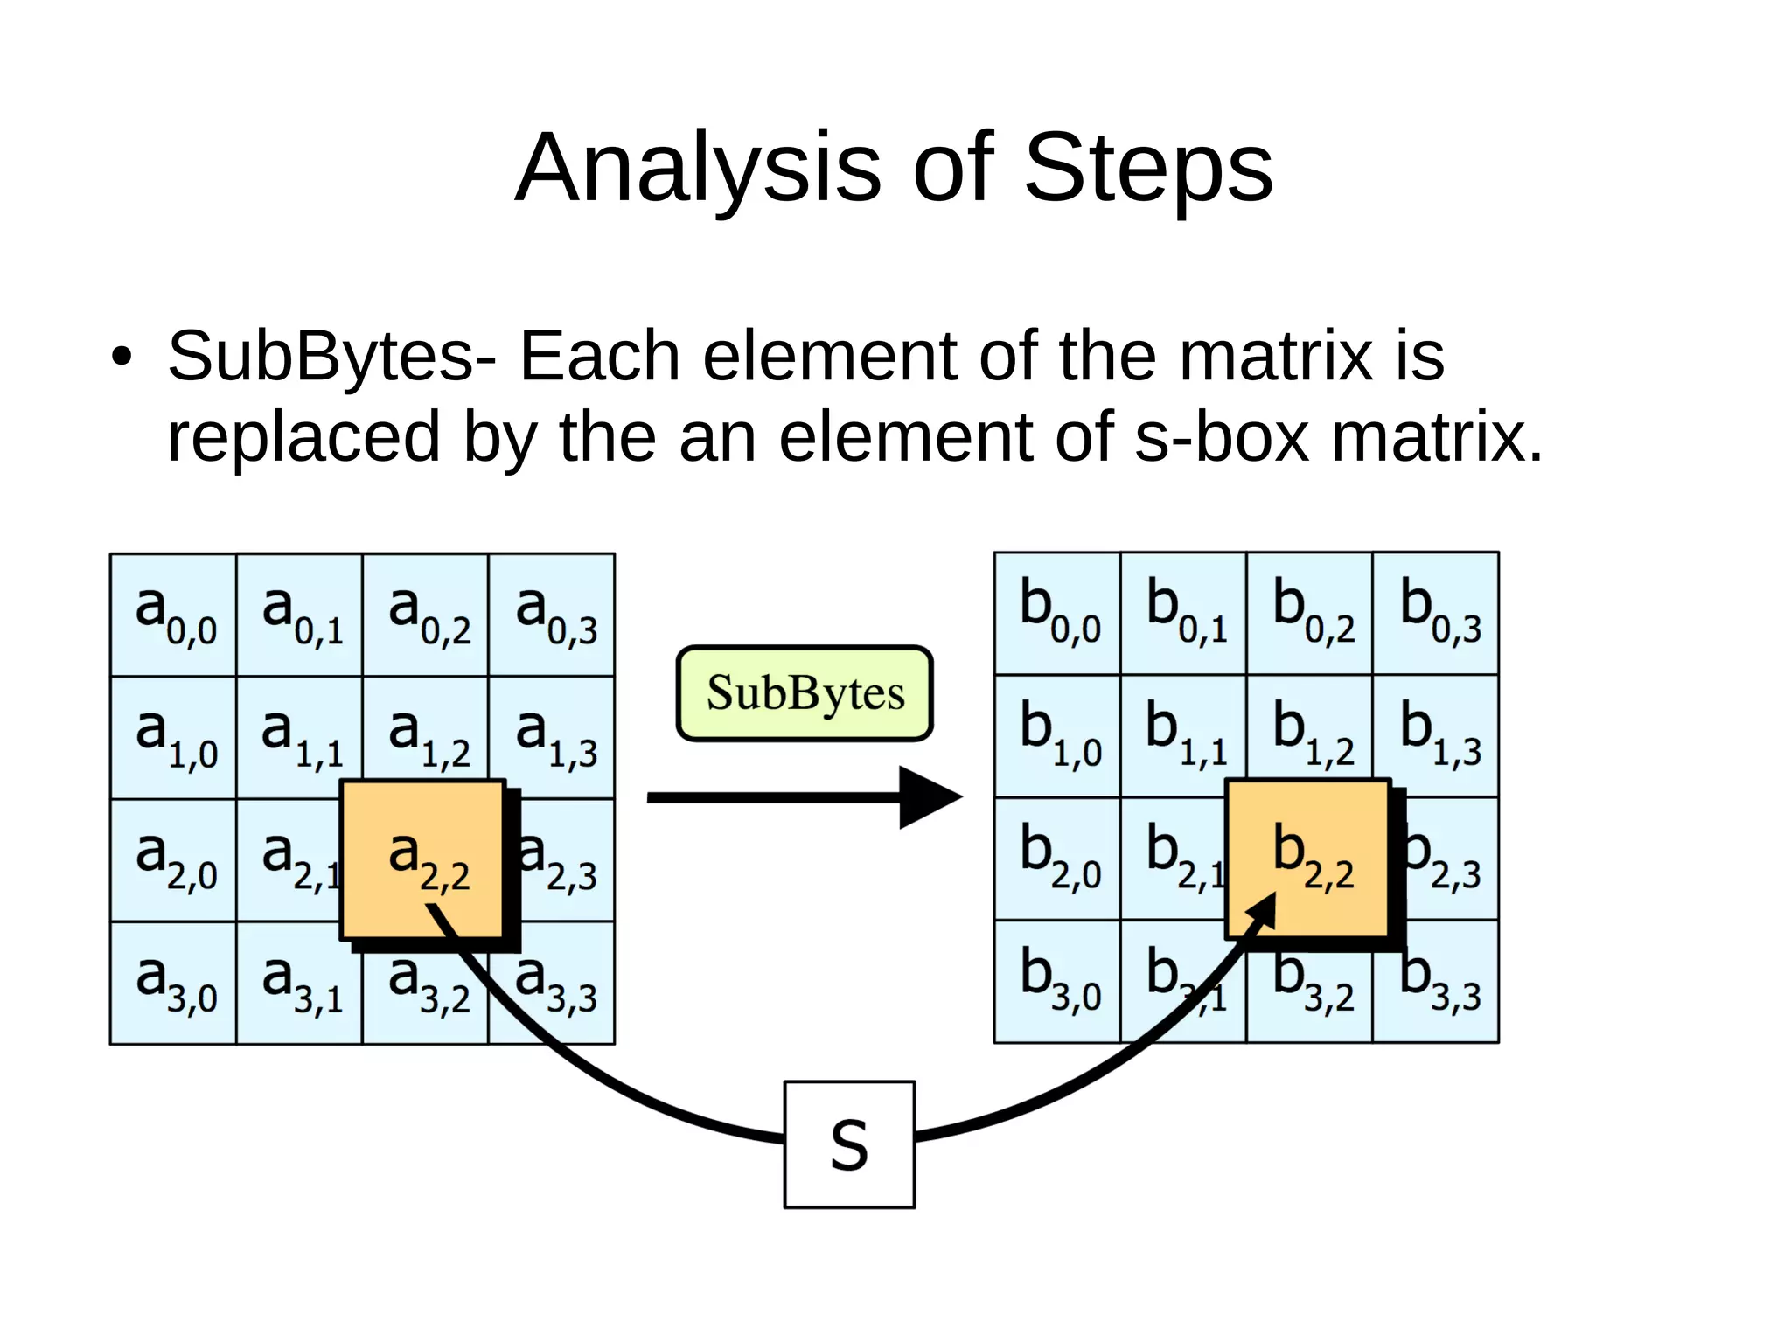
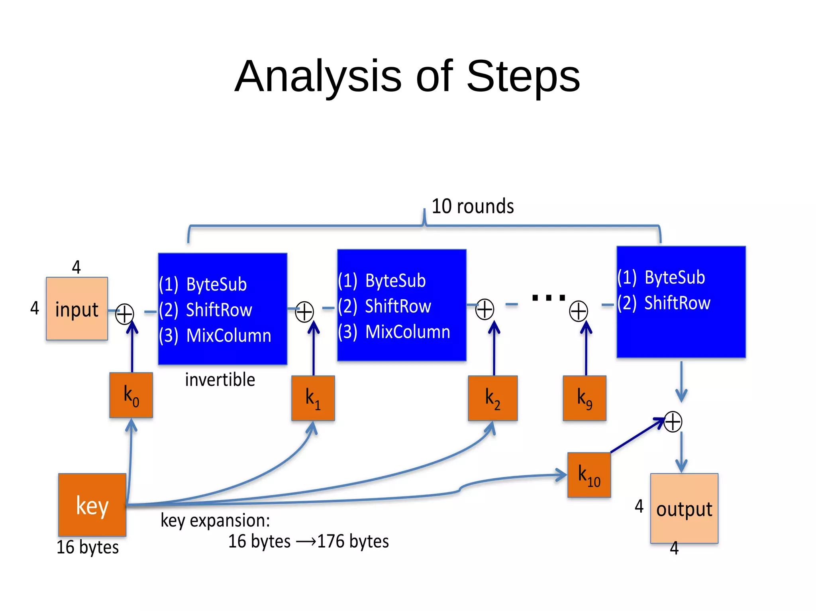
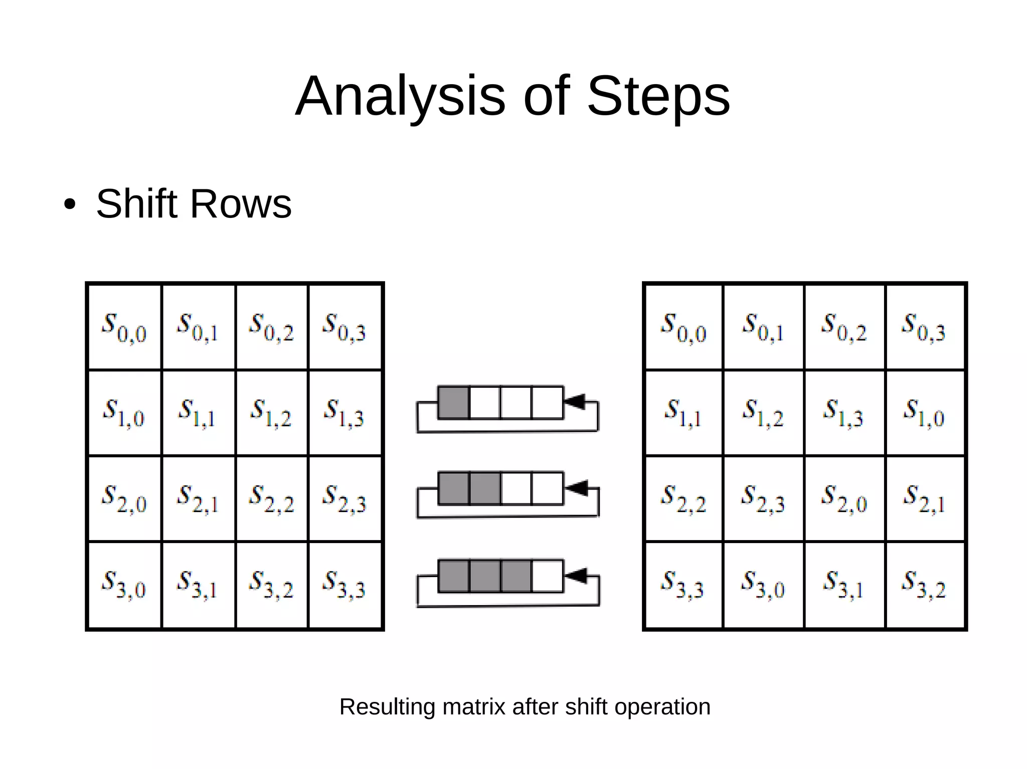
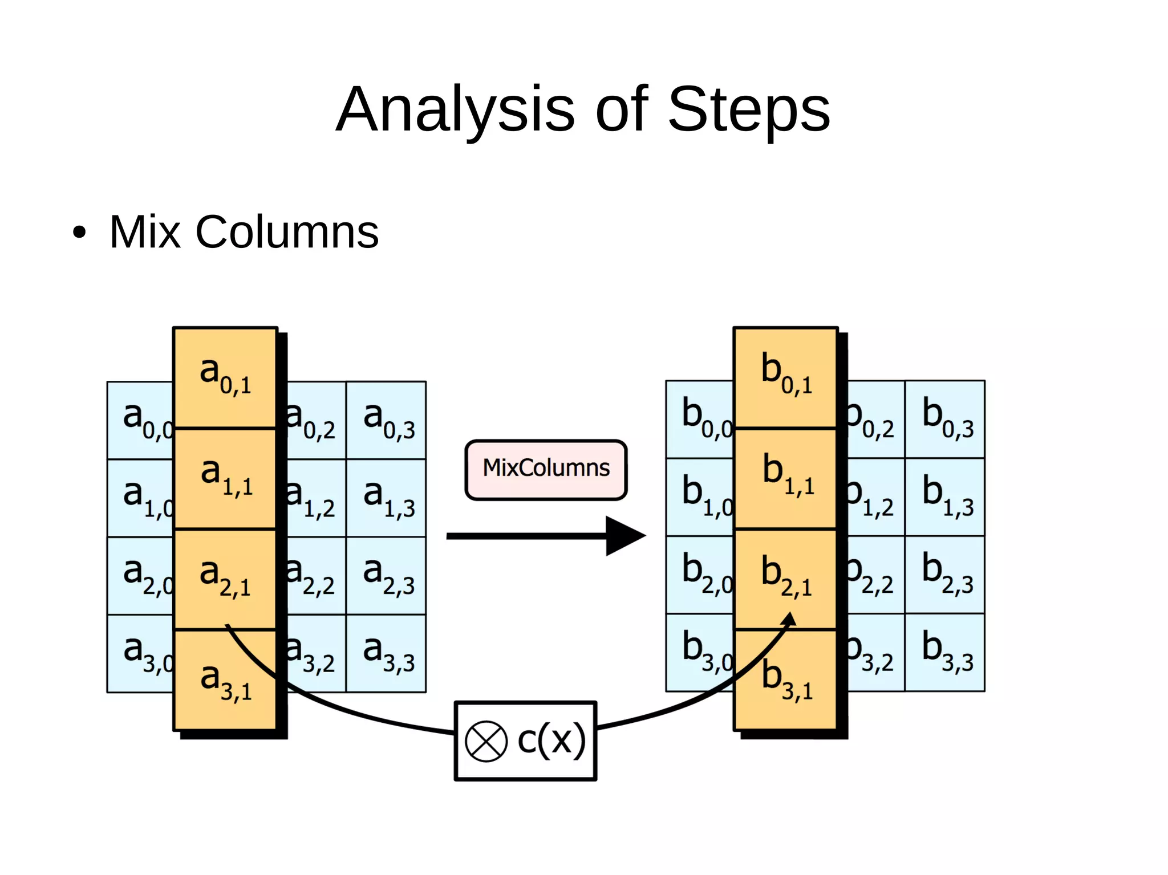

Slide 15
Key management
Key management is a critical aspect of symmetric key encryption. The key must be kept secret from unauthorized parties and must be securely shared between parties that need to decrypt the data. Key management includes key generation, key exchange, key storage, and key destruction.

Slide 16
Strengths and weaknesses of symmetric key encryption
Symmetric key encryption has several strengths, including:
Fast and efficient encryption and decryption
Strong encryption when using long keys
Easy to implement and use
However, symmetric key encryption also has weaknesses, including:
The need to securely share the key between parties
The possibility of key compromise if the key is intercepted or stolen
The lack of key distribution and management in large-scale systems

Slide 17
Examples of symmetric key encryption in practice
Symmetric key encryption is widely used in practice. Here are some examples:
1. Secure Socket Layer (SSL) and Transport Layer Security (TLS): SSL and TLS are protocols used to secure internet communications, such as web browsing, email, and instant messaging. These protocols use symmetric key encryption to encrypt data exchanged between the client and server.
2. Virtual Private Networks (VPNs): A VPN is a secure tunnel that allows remote users to access a private network over the internet. VPNs use symmetric key encryption to protect the data transmitted between the remote user and the private network. For example, the OpenVPN protocol uses AES encryption for data encryption.
3. Wireless networks: Wi-Fi networks use symmetric key encryption to protect data transmitted between devices and the wireless access point. The most widely used encryption standard for wireless networks is Wi-Fi Protected Access (WPA2), which uses AES encryption.
4. Messaging apps: Many messaging apps, such as WhatsApp, Signal, and Telegram, use symmetric key encryption to protect the privacy of users' messages. The symmetric key is generated and shared between the sender and receiver, and then used to encrypt and decrypt messages.

Slide 18
Conclusion
Symmetric key encryption is a powerful tool for protecting data from unauthorized access. It works by applying a mathematical algorithm to plain text to generate cipher text, using a single key for both encryption and decryption. While symmetric key encryption has strengths such as fast and efficient encryption and decryption and easy implementation, it also has weaknesses such as the need to securely share the key between parties and the possibility of key compromise. Overall, symmetric key encryption is widely used in various applications, such as secure communication, data storage, financial transactions, mobile devices, and the Internet of Things.

Slide 19
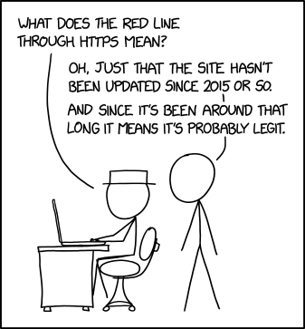
Thank you
https://xkcd.com/2634/

